Slide 1
Linear Algebra
Lecture 25

Slide 2
Vector Spaces

Slide 3
Rank

Slide 4
The Row Space
If A is an m x n matrix, each row of A has n entries and thus can be identified with a vector in R^{n}. The set of all linear combinations of the row vectors is called the row space of A and is denoted by Row A. …

Slide 5
continued
Each row has n entries, so Row A is a subspace of R^{n}. Since the rows of A are identified with the columns of A^{T}, we could also write Col A^{T} in place of Row A.

Slide 6
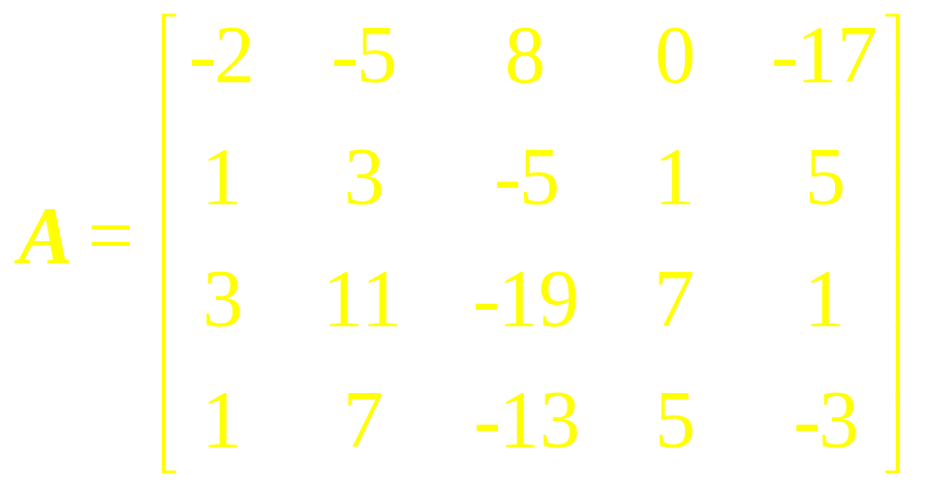
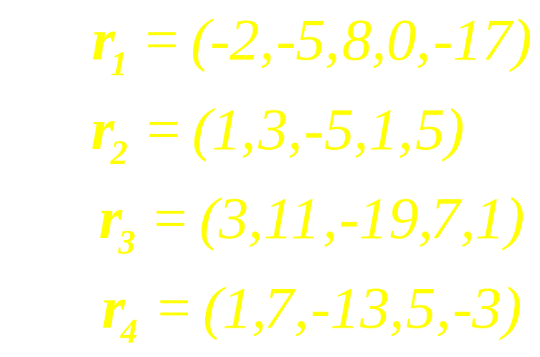
Example 1
The row space of A is the subspace of R⁵ spanned by {r₁, r₂, r₃, r₄ }.

Slide 7
Theorem
If two matrices A and B are row equivalent, then their row spaces are the same. If B is in echelon form, the nonzero rows of B form a basis for the row space of A as well as B.

Slide 8
Theorem
If A and B are row equivalent
matrices, then
(a) A given set of column
vectors of A is linearly
independent if and only if the
corresponding column vectors
of B are linearly independent.

Slide 9
continued
(b) A given set of column
vector of A forms a basis for
the column space of A if and
only if the corresponding
column vector of B forms a
basis for the column space
of B.

Slide 10
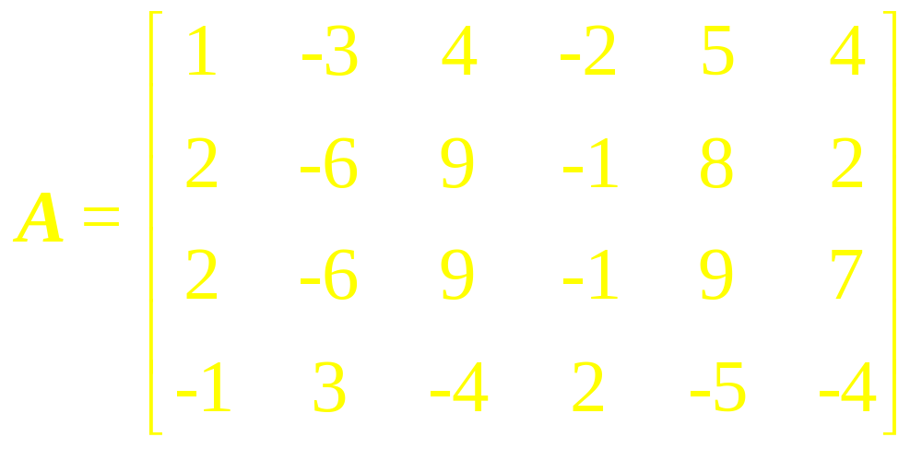
Example 2
Find the bases for the row and column spaces of

Slide 11
Solution Since elementary row operations do not change the row space of a matrix, we can find a basis for the row space of A by finding a basis for the row space of any row-echelon form of A.

Slide 12
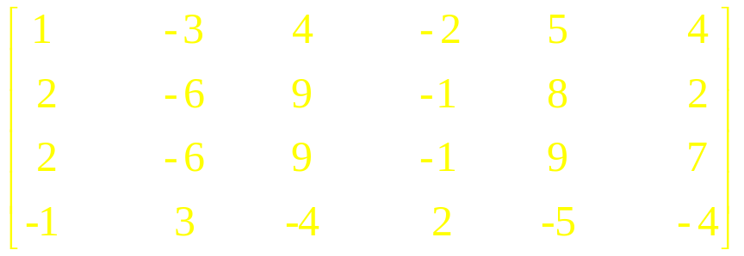
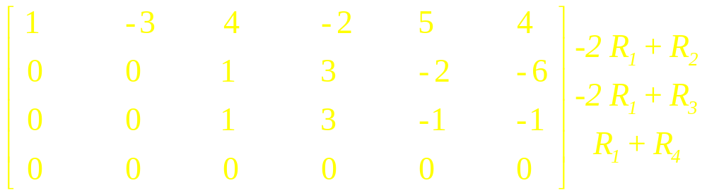
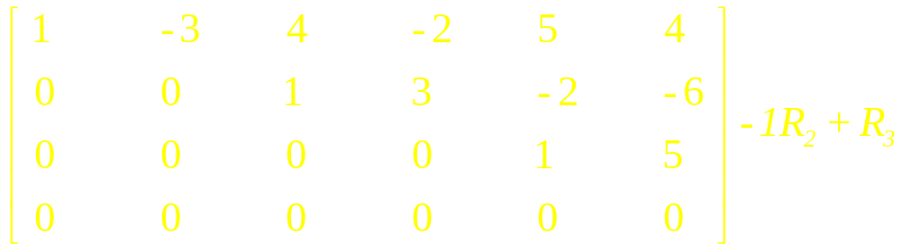
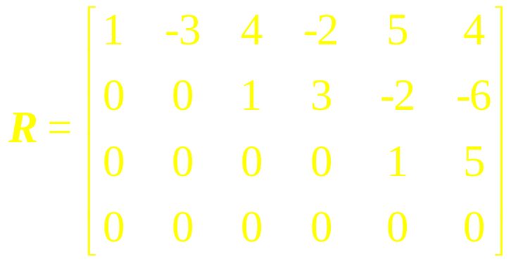

Slide 13
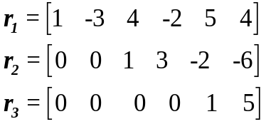
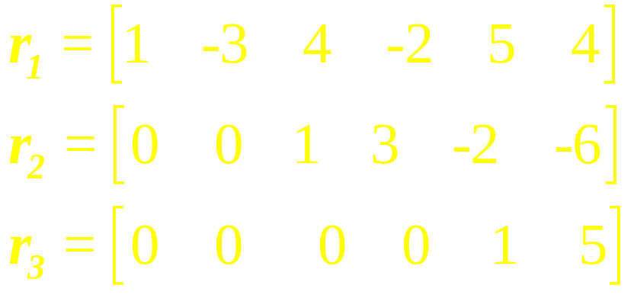
Now using the theorem (1) the non-zero vectors of R form a basis for the row space of R, and hence form bases for the row space of A. these bases vectors are

Slide 14
Keeping in mind that A and R may have different column spaces, we cannot find a basis for the column space of A directly from the column vectors of R. however, it follows from the theorem (2b) if we can find a set of column vectors of R that forms a basis for the column space of R, then the corresponding column vectors of A will form a basis for the column space of A.

Slide 15
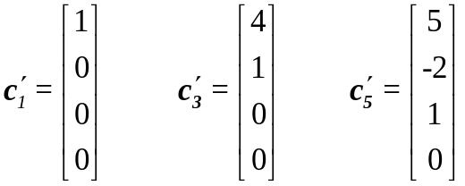
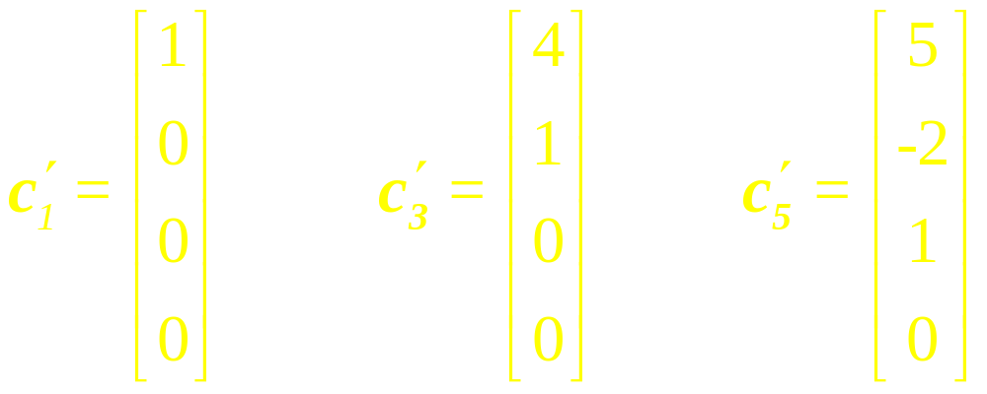
The first, third, and fifth columns of R contains the leading 1’s of the row vectors, so
form a basis for the column space of R, thus the corresponding column vectors of A

Slide 16
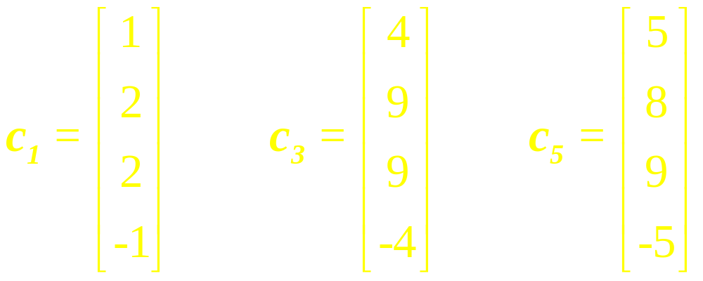
form a basis for the column space of A.

Slide 17
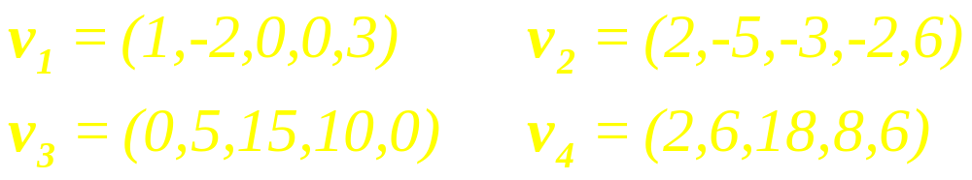
Example 3
Find bases for the space spanned by the vectors

Slide 18
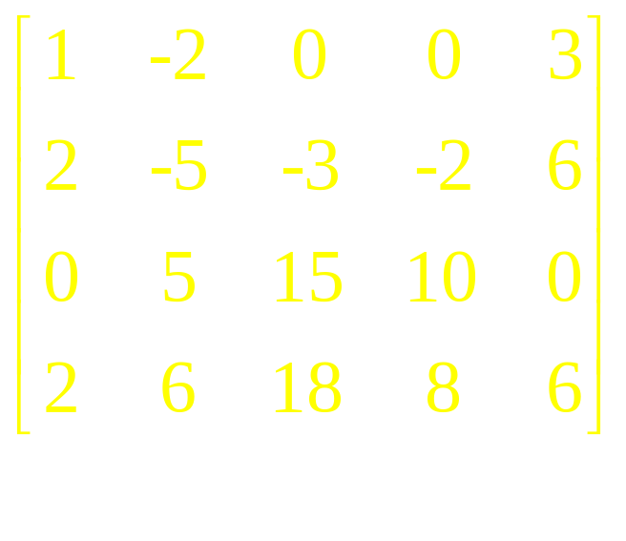
Solution Except for a variation in notation, the space spanned by these vectors is the row space of the matrix

Slide 19
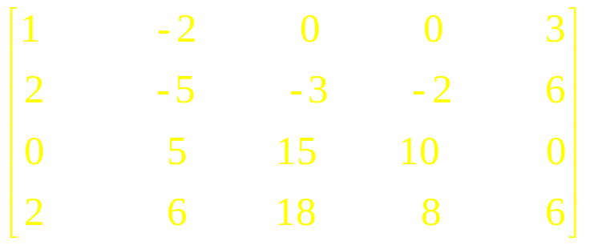
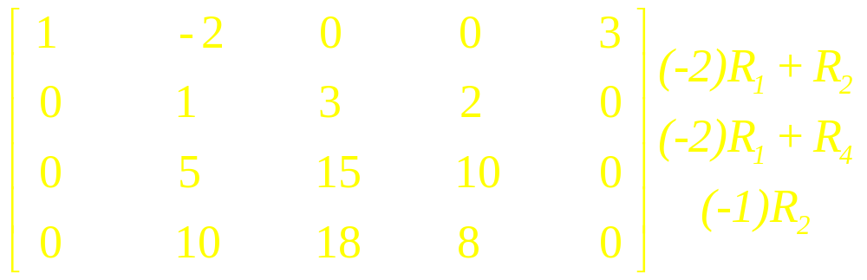
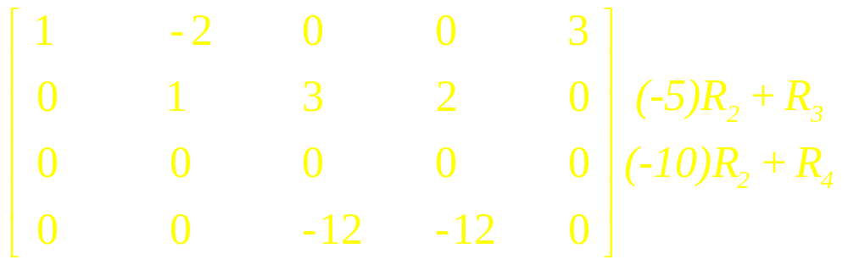
Transforming Matrix to Row Echelon Form:

Slide 20
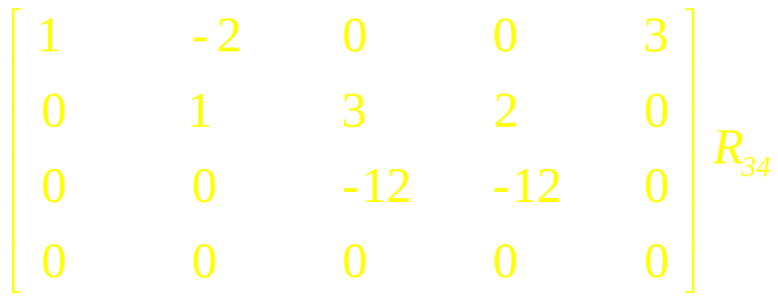
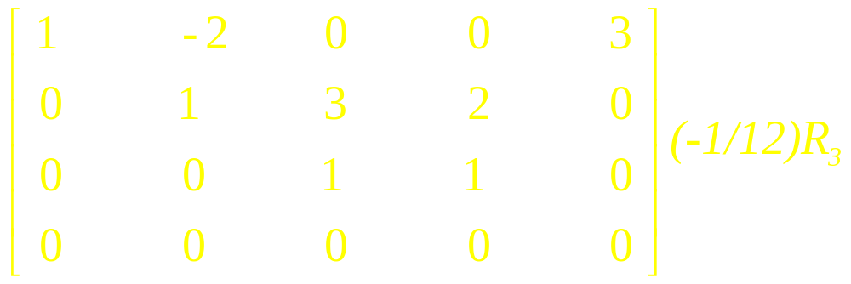
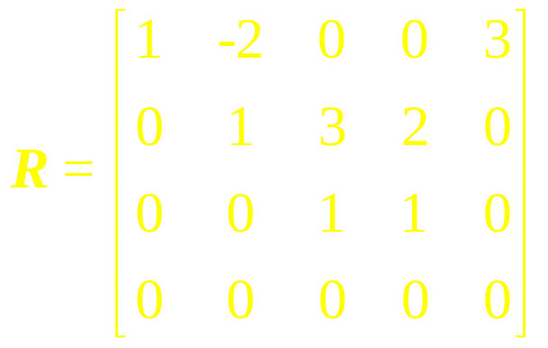
Therefore,

Slide 21
The non-zero row vectors in this matrix are
These vectors form a basis for the row space and consequently form a basis for the subspace of R⁵ spanned by v₁, v₂, v₃.

Slide 22
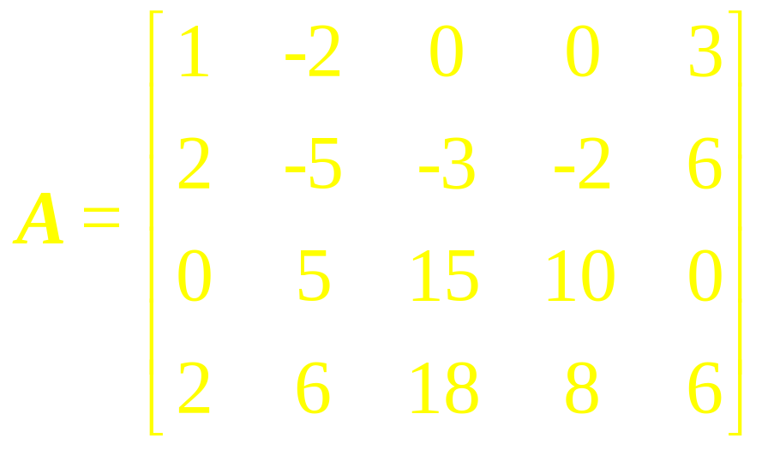
Example 4
Find a basis for the row space of A consisting entirely of row vectors from A, where

Slide 23
Solution We will transpose A, thereby, converting the row space of A into the column space of A^{T}; then we will use the method of example (2) to find a basis for the column space of A^{T}; and then we will transpose again to convert column vectors back to row vectors. Transposing A yields

Slide 24
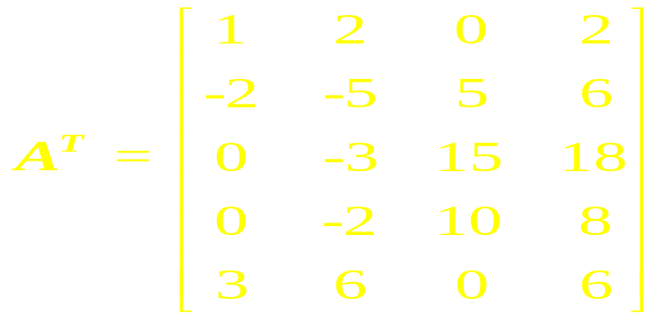
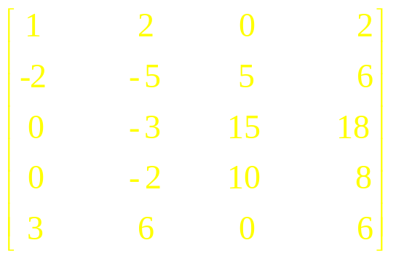
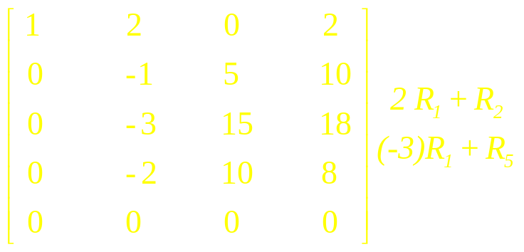
Transforming Matrix to Row Echelon Form:

Slide 25
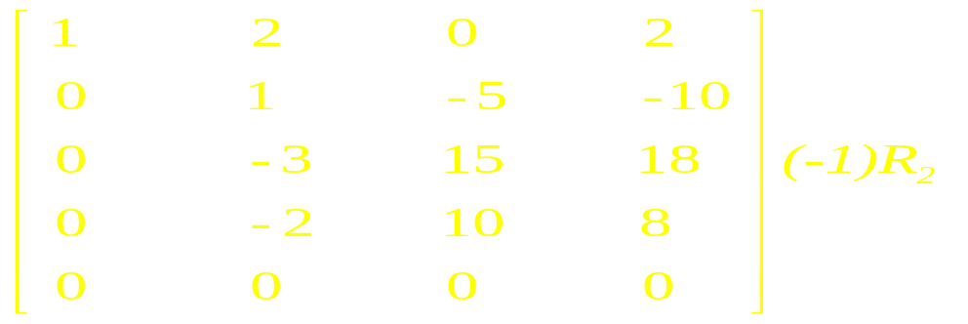
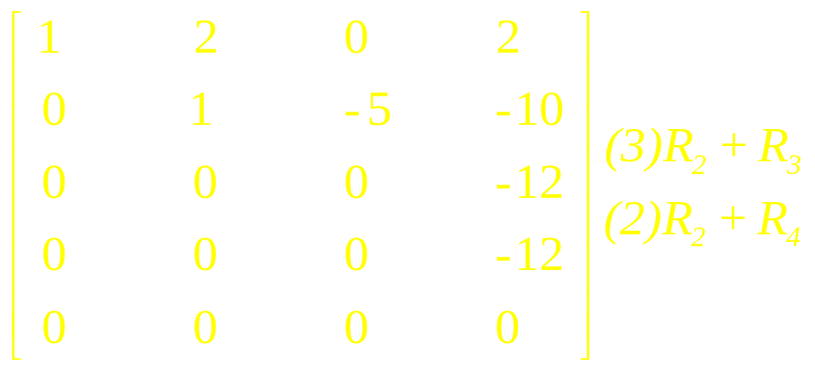
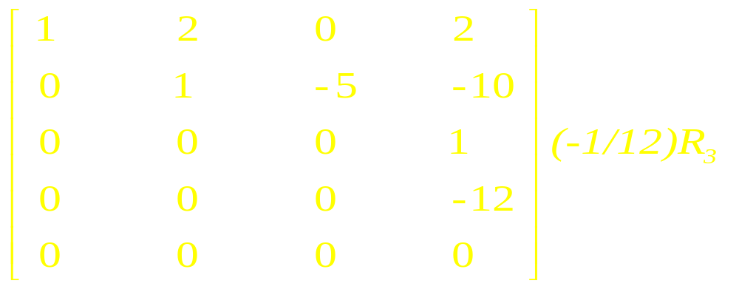

Slide 26
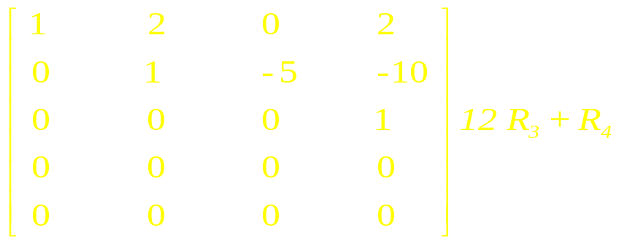
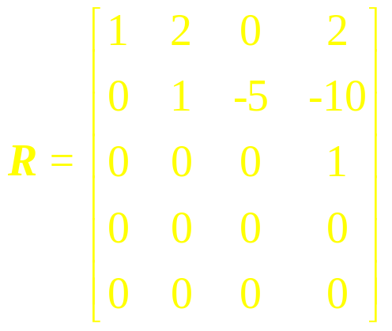
The first, second and fourth columns contain the leading 1’s,
so the corresponding column vectors in A^{T} form a basis for the
column space of A^{T}; these are

Slide 27
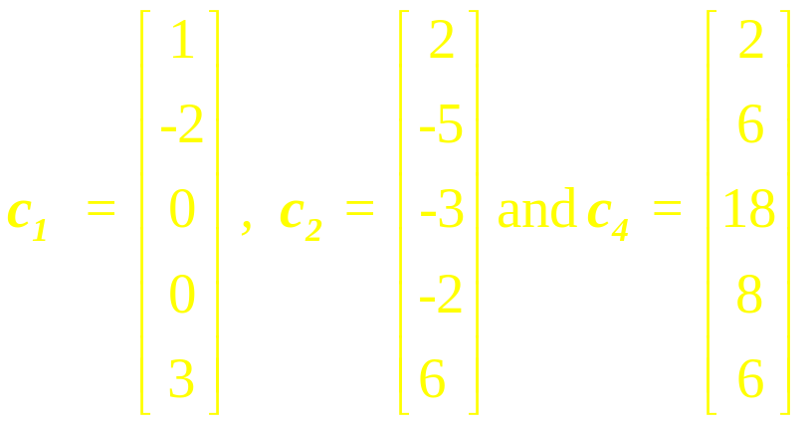
Transposing again and adjusting the notation appropriately yields the basis vectors
for the row space of A.

Slide 28
The main result of this lecture involves the three spaces: Row A, Col A, and Nul A. The following example prepares the way for this result and shows how one sequence of row operations on A leads to bases for all three spaces.

Slide 29
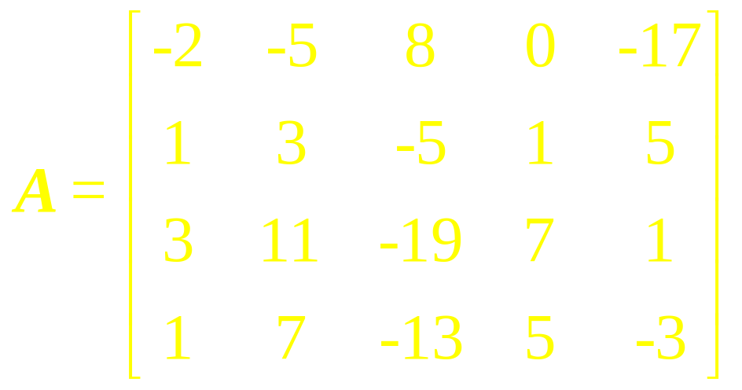
Example 5
Find bases for the row space, the column space and the null space of the matrix

Slide 30
Definition
The rank of A is the dimension of the column space of A. Since Row A is the same as Col A^{T}, the dimension of the row space of A is the rank of A^{T}. The dimension of the null space is sometimes called the nullity of A.

Slide 31
The Rank
Theorem

Slide 32
The Rank Theorem
The dimensions of the column space and the row space of an m x n matrix A are equal. This common dimension, the rank of A, also equals the number of pivot positions in A and satisfies the equation
rank A + dim Nul A = n

Slide 33
Examples

Slide 34
Theorem
If A is an m x n, matrix, then
(a) rank (A) = the number of leading variables in the solution of Ax = 0
(b) nullity (A) = the number of parameters in the general solution of Ax = 0

Slide 35
Example 11
Find the number of parameters in the solution set of Ax = 0 if A is a 5 x 7 matrix of rank 3.
nullity (A)=n-rank (A)=7-3=4
There are four parameters.

Slide 36
Theorem
If A is any matrix, then
rank (A) = rank (A^{T})

Slide 37
Four Fundamental
Matrix Spaces
Row space of A
Column space of A
Null space of A
Null space of A^{T}

Slide 38
Suppose that A is an m x n
matrix of rank r, A^{T} is an n x m
matrix of rank r .
Fundamental space Dimension
Row space of A r
Column space of A r
Null space of A n-r
Null space of A^{T} m-r

Slide 39
Example 12
If A is a 7 x 4 matrix, then the rank of A is at most 4 and, consequently, the seven row vectors must be linearly dependent. …

Slide 40
continued
If A is a 4 x 7 matrix, then again the rank of A is at most 4 and, consequently, the seven column vectors must be linearly dependent.

Slide 41
Invertible
Matrix
Theorem

Slide 42
Invertible Matrix Theorem
Let A be an n x n matrix. Then the following statements are each equivalent to the statement that A is an invertible matrix. …

Slide 43
The columns of A form a basis of R^{n}.
Col A = R^{n}
dim Col A = n
rank A = n
Nul A = {0}
dim Nul A = 0

Slide 44
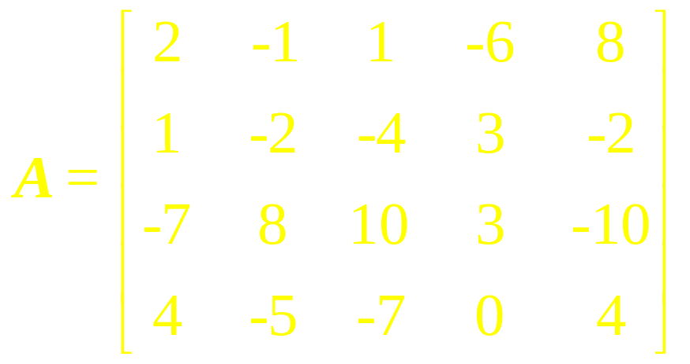
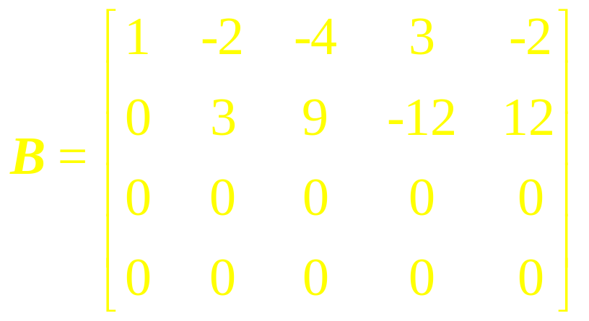
Example 13
The matrices below are row
equivalent

Slide 45
1. Find rank A and dim Nul A.
2. Find bases for Col A and
Row A.
3. What is the next step to
perform if one wants to find a
basis for Nul A?
4. How many pivot columns
are in a row echelon form of
A^{T}?

Slide 46
Linear Algebra
Lecture 25

